Slide 1

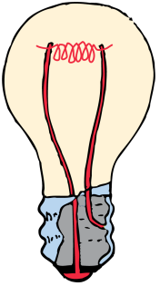

Light is the ONLY thing you see! All visible objects either emit or reflect light.

Slide 2
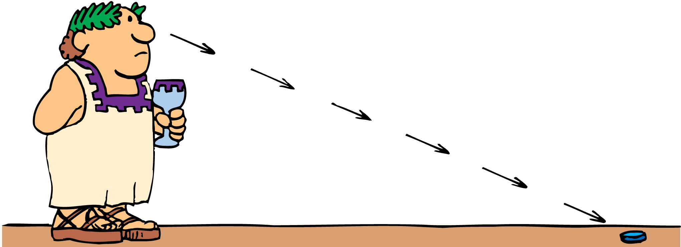
Early Concepts of Light
Light has been studied for thousands of years.
Some ancient Greek philosophers thought that light consists of tiny particles, which enter the eye to create the sensation of vision.
Others thought that vision resulted from streamers or filaments emitted by the eye making contact with an object.

Slide 3
Early Concepts of Light
Up until the time of Newton and beyond, most philosophers and scientists thought that light consisted of particles.
However, one Greek, Empedocles, thought that light traveled in waves.
One of Newton’s contemporaries, the Dutch scientist Christian Huygens, also argued that light was a wave.

Slide 4
Early Concepts of Light
The particle theory was supported by the fact that light seemed to move in straight lines instead of spreading out as waves do.
The wave theory became the accepted theory in the nineteenth century.

Slide 5
Early Concepts of Light
In 1905, Einstein published a theory explaining the
photoelectric effect.
According to this theory, light consists of particles called photons, massless bundles of concentrated electromagnetic energy.
Scientists now agree that light has a dual nature, part particle and part wave.

Slide 6
Electromagnetic Waves
The electromagnetic spectrum consists of radio waves, microwaves, infrared, light, ultraviolet rays, X-rays, and gamma rays.
Light is energy that is emitted by accelerating electric charges—often electrons in atoms.
This energy travels in a wave that is partly electric and partly magnetic. Such a wave is an electromagnetic wave.

Slide 7
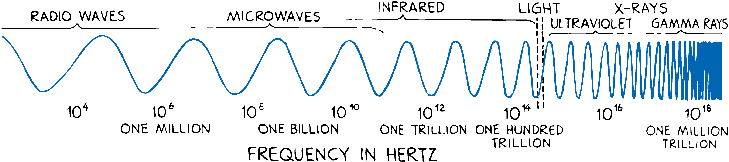
Electromagnetic Waves
Light is a portion of the family of electromagnetic waves that includes radio waves, microwaves, and X-rays.
The range of electromagnetic waves is called the electromagnetic spectrum.

Slide 8
Electromagnetic Waves
The lowest frequency of light we can see appears red. The highest visible light, violet, has nearly twice the frequency of red light.
Electromagnetic waves of frequencies lower than the red of visible light are called infrared. Heat lamps give off infrared waves.
Electromagnetic waves of frequencies higher than those of violet are called ultraviolet. They are responsible for sunburns.

Slide 9

Shadows
When light shines on an object, some of the rays may be stopped while others pass on in a straight-line path.

Slide 10
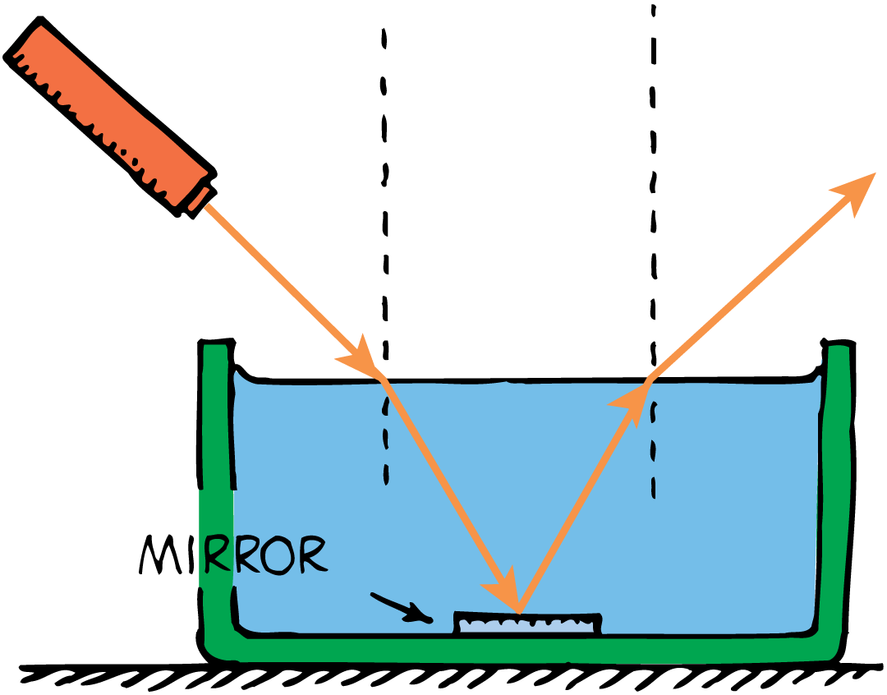
Shadows
A thin beam of light is often called a ray.
Any beam of light—no matter how wide—can be thought of as made of a bundle of rays.
A shadow is formed where light rays cannot reach.

Slide 11
Shadows
Sharp shadows are produced by a small light source nearby or by a larger source farther away.
However, most shadows are somewhat blurry, with a dark part on the inside and a lighter part around the edges.
A total shadow is called an umbra.
A partial shadow is called a penumbra. A penumbra appears where some of the light is blocked but where other light fills in.

Slide 12
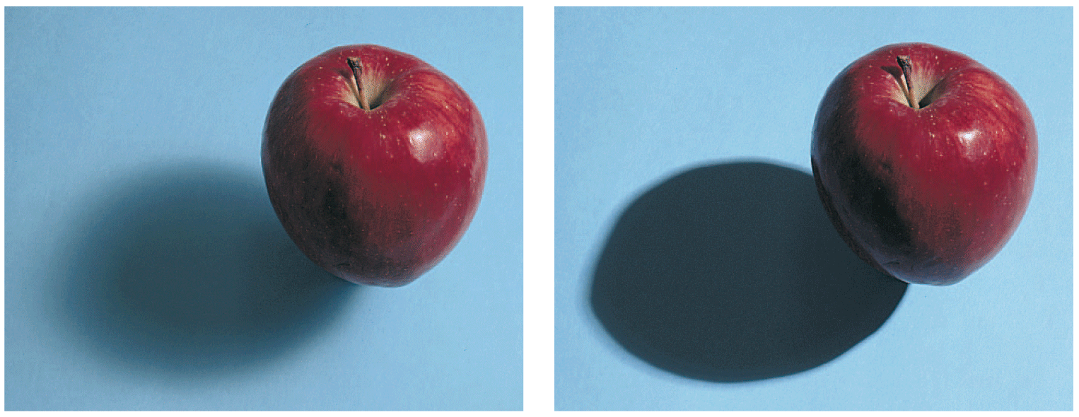
Shadows
A large light source produces a softer shadow than a smaller source.

Slide 13
Polarization
Light that reflects at glancing angles from nonmetallic surfaces, such as glass, water, or roads, vibrates mainly in the plane of the reflecting surface.

Slide 14
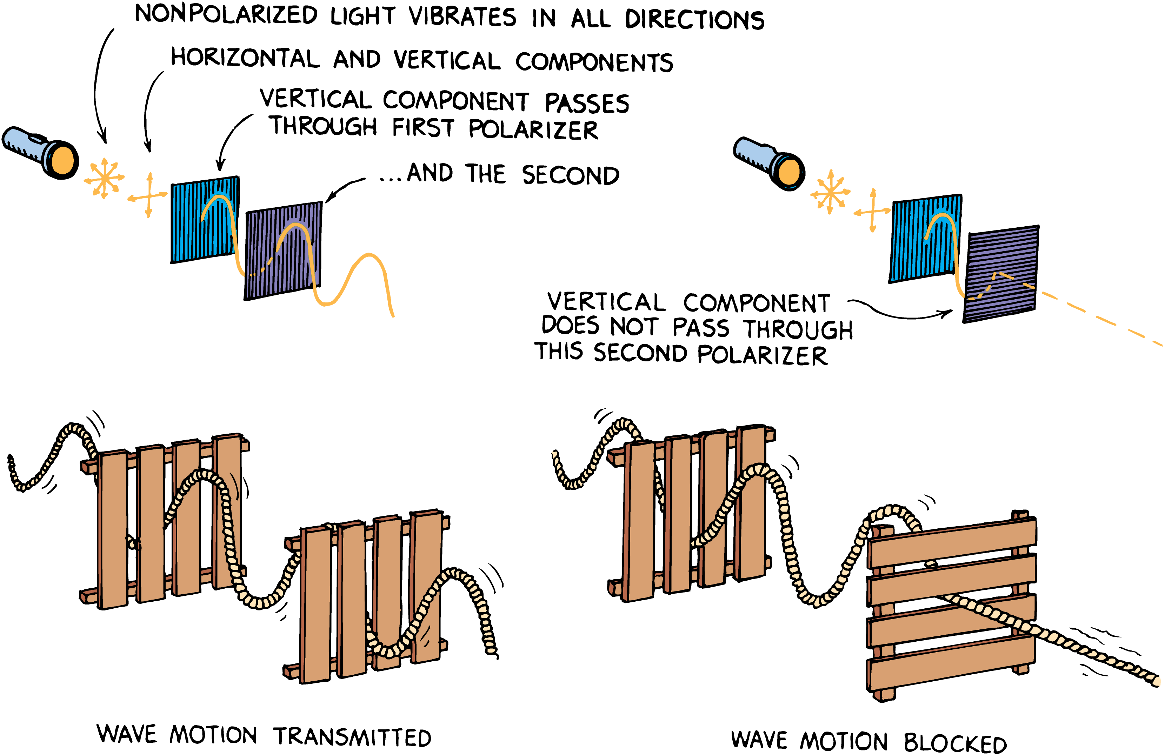
Polarization

Slide 15
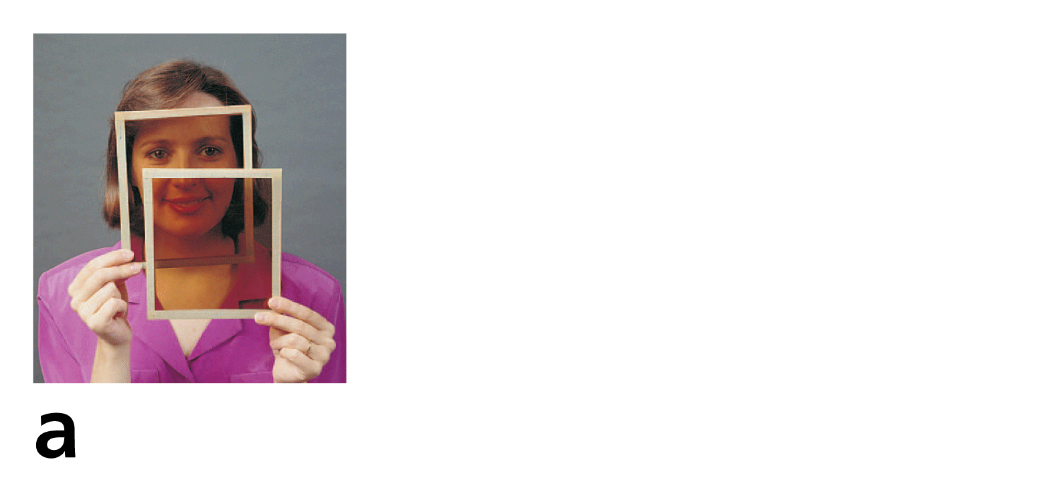
27.7 Polarization
Light is transmitted when the axes of the polarizing filters are aligned.

Slide 16
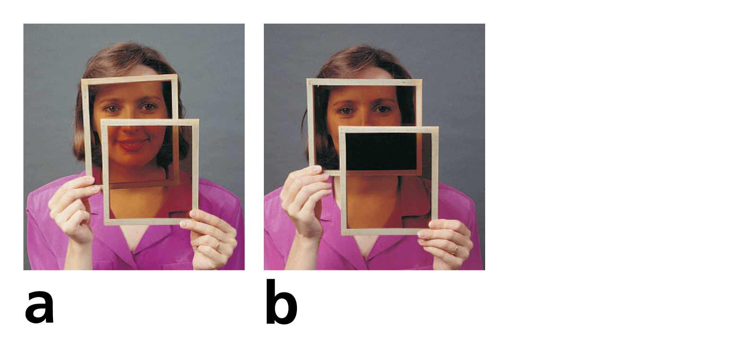
27.7 Polarization
Light is transmitted when the axes of the polarizing filters are aligned.
Light is absorbed when they are at right angles to each other.

